Slide 1





IoT Honeypot with Raspberry Pi and DHT11 Sensor
Lazaros Papakostas
International Hellenic University
Course: Internet of Things
Professor: Dr. Stavrinides

Slide 2
Table of Contents
Project Overview
Hardware Setup
Software Components
Core Functionality
Honeypot Mechanism
Telegram Integration
Challenges Faced
Video Example

Slide 3

Project Overview
IoT system on Raspberry Pi using DHT11
REST API with Flask
Honeypot for detecting suspicious access
Telegram for real-time alerts

Slide 4
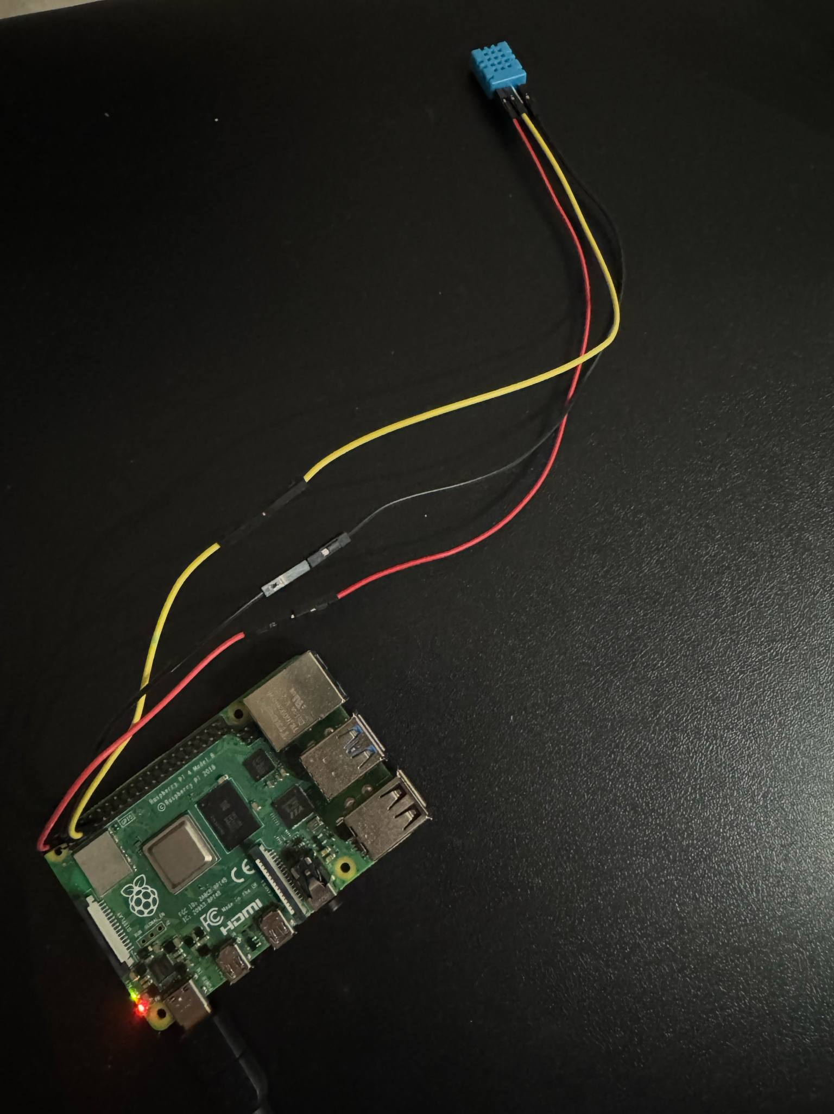
Hardware Setup
Raspberry Pi 4 Model B
DHT11 sensor
Jumper wires
MicroSD card
Power supply

Slide 5
Software Components
Python 3
Flask (web framework)
Adafruit DHT library
Requests (Telegram API)
Telegram bot

Slide 6
Core Functionality
• Read sensor data (temperature, humidity)
• Serve JSON over REST API (/sensor/data)
• Log access attempts (IP, path, User-Agent)
• Detect suspicious access (/admin, /config, /hidden)
• Count repeated suspicious IPs

Slide 7
Honeypot Mechanism
• Fake admin/config/hidden routes
• Log suspicious requests
• Terminal alerts
• Count per-IP suspicious attempts
•Telegram alerts

Slide 8
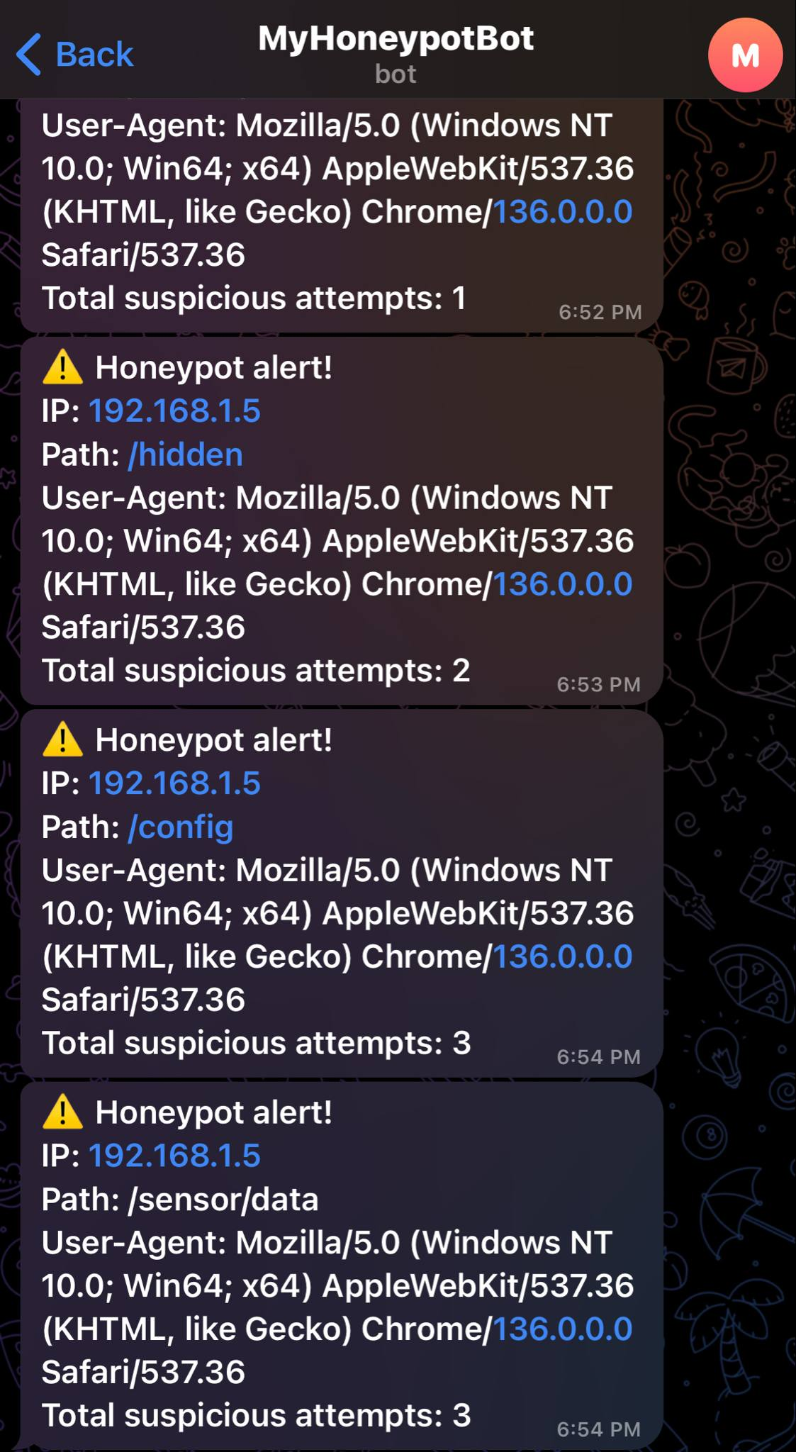
Telegram Integration
Used Telegram Bot API
• Created bot + token
• Sent alerts: IP, path, user-agent, count
Example:
⚠️ Honeypot alert!
IP: 192.168.1.5
Path: /hidden
Total suspicious attempts: 2

Slide 9
Challenges Faced
Little to no prior experience in Python or IoT
DHT11 sensor issues
Running Flask on Raspberry Pi
REST API integration

Slide 10
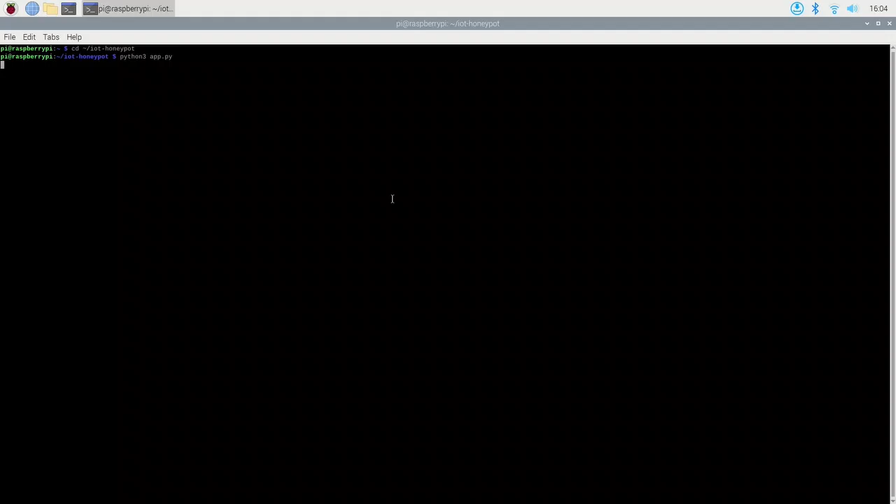
Video Example

